Slide 1
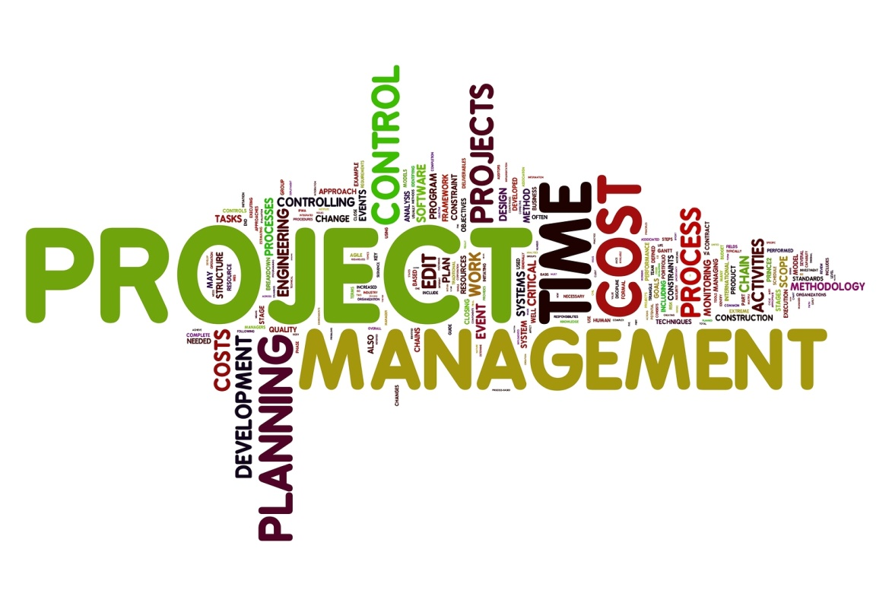
Bijay Rijal

Slide 2
Outline
Project and Project Management
Challenges of Project Management
Types of Project Management System
Need of Project Management System
Scope of Project Management System
Drawbacks
Examples

Slide 3
What is a Project?
A definite start and end point
Attempts to achieve something new
Project is over once the end point is reached

Slide 4
What is Project Management?
“Project Management is the planning, organizing, directing and controlling resources to complete specific goals and objectives”

Slide 5
Challenge of Project Management
Time
Scope
Quality
Cost

Slide 6
Project Management System

Slide 7
Types
Desktop
Web- based
Single user
Collaborative
Visual

Slide 8
Why we need Project Management System?
Collaboration
Scheduling
Resource assignment
Cost control and budget management
Quality management
Tracking
Report generation

Slide 9
Scope
Project Based Organizations
Process Based Organizations
Software Developers
Utilities
Construction
Manufacturers
Consultants
NGOs
Advertising agencies
Governments Departments

Slide 10
Drawbacks
Costly
Not suitable for small projects
May fail to meet the requirements
Extra training for the project members
Time consuming
May generate complex reports

Slide 11
Examples
Mavenlink
Smartsheet
Wrike
LiquidPlanner
Workfront
WorkZone

Slide 12
Thank You

